Slide 1
CSCM10: Presentation
Andrew Gray
445348

Slide 2
Contents
Motivation
Background Information
Aims of the Project
Project Steps
Current Steps
References

Slide 3
Motivation
“It is predicted that by 2025, the global AI market is expected to be almost $60 billion; in 2016, it was just $1.4 billion. Another research says that AI bots will drive up to $33 trillion of annual economic growth and also power 85% of customer service interactions by 2020 [1].”
"Despite popular opinions, games promote learning and discourage negative behaviours. One study illustrates that regular gameplay improved mental health as well as cognitive and social skills [2].”

Slide 4
Motivation
Many people perceive ML to be a black box
ML is a complex technique to master
underlining factors of ML are relatively simple
Trying to debunk the misconceptions around AI and ML,
Tool that can help educate the concepts of ML
Create a teaching and learning tool that incorporates gamification features
Aiming to help change the concept of ML

Slide 5
Contents
Motivation
Background Information
Aims of the Project
Project Steps
Current Steps
References

Slide 6
Background Information
Two main areas of Focus:
Gamification
Artificial Intelligence:
Machine Learning.
https://www.aliexpress.com/i/32893627970.html
bbc

Slide 7
Background Information
Supervised and Unsupervised Learning
Linear Regression
Logistic Regression
K-Means
Gaussian Mixture Models
Support Vector Models
PCA and LDA
Will cheng

Slide 8
Background Information
Leader boards
Levels
Challenges
Badges
Points
Check-in
Feedback
Game services

Slide 9
Contents
Motivation
Background Information
Aims of the Project
Project Steps
Current Steps
References

Slide 10

Aims of the Project
https://www.pngfind.com/mpng/TJxTJR_python-logo-png-transparent-background-python-logo-png/
https://www.pyimagesearch.com/2019/01/21/regression-with-keras/

Slide 11
Contents
Motivation
Background Information
Aims of the Project
Project Steps
Current Steps
References

Slide 12
Steps for the Project
Gain better fundamentals of Pygame
Start implementing the main game screen
Starting implementing the ML models
Start incorporating the ML Model into the game
Develop levels (Different Models)
Incorporate Multiplayer
Incorporate Learning Material(s) –
Websites
Videos
Develop Difficulty Settings

Slide 13
Contents
Motivation
Background Information
Aims of the Project
Project Steps
Current Steps
References

Slide 14
Current First Steps
https://www.nintendo.co.uk/Games/NES/Super-Mario-Bros--803853.html

Slide 15
Current First Steps
https://ealdaylight.com/progressive-brainstorm/

Slide 16
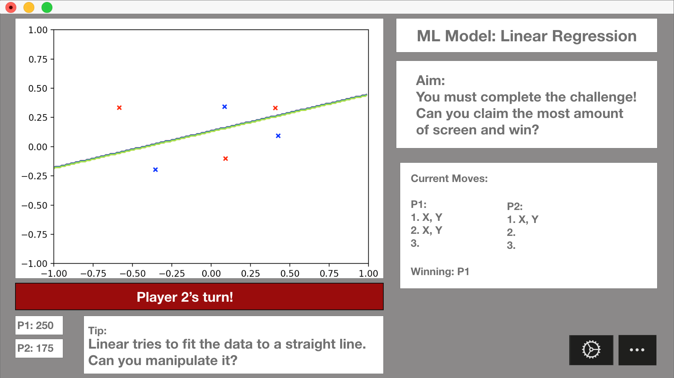
Current First Steps

Slide 17
Contents
Motivation
Background Information
Aims of the Project
Project Steps
Current Steps
References

Slide 18
References
http://www.pygame.org/docs/logos.html
https://imgbin.com/png/SxK5hnmc/learning-to-program-using-python-programming-language-computer-programming-the-python-papers-anthology-png
https://www.bbc.co.uk/newsround/49274918
https://github.com/WillCheung2016
https://hurix.com/selecting-gamification-services/
https://www.polygon.com/features/2017/11/8/16621744/the-best-mario-games

